Slide 1
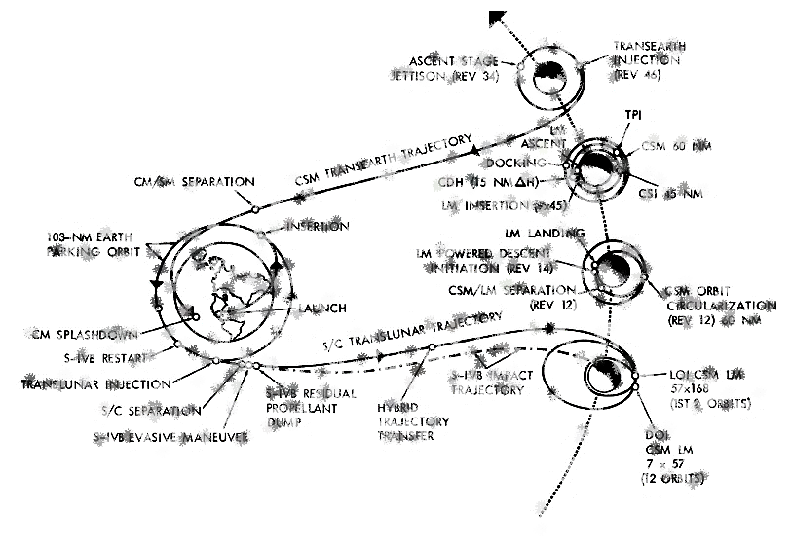
Research Seminar for ED&G
Week 5
Multi-dimensional Fixed Effect
& The Gravity Model

Slide 2
Outline of Today
Multi-dimensional Fixed Effect & Examples
What is the Gravity model of trade & what do we use it for?
  PPML method in estimation
  Walkthrough of an empirical research that may give you some inspirations for master thesis.

Slide 3

Multi-dimensional Fixed Effects
Fixed Effect Model we discussed with Panel models
Fixed Effects Model
  Individual-specific intercept = “constant term” = “fixed effect”
Known Issues:
  “Overkill”
  (Large) loss in efficiency in very “wide” panels
  Sometimes panel model simply impossible, e.g. the same individuals not repeatedly observed
Individual fixed effect. Different across individuals, but the same over time for a same individual.
They are still the same for all individuals

Slide 4
Multi-dimensional Fixed Effects
The core of our study is the properties that doesn’t, or rarely change over time:
  Race and gender discrimination,
  Wage differences across regions in Europe, etc
Too wide panel
  Little number of periods of data; also low number of individuals in multiple periods. In micro statistics / marketing data it’s very often.
Impossible to constructing a panel
  Fully anonymous data
  (Vast) majority individuals only observed for just one period…
Instead of “individual” fixed effect, we replace the individual intercept in the regression by a set of dummies, representing fixed effects related to properties from different dimensions

Slide 5
Hierarchical fixed effects
Consider country-industry-year data.
“Typical” setup of panel:
  Individual identifier = “paired” country-industry
  “Electronics” in “Italy”, “Textile” in “Ireland”.
Alternatives:
  Only control for fixed effect in one dimension
  (i.e. only country or industry dummies)
  Control for both sets of dummies, but not “paired”.
  The two methods both work, even there is only 1 year of data.
Often used as robustness check, or as a detection about where comes the variations in the data.

Slide 6
Hierarchical fixed effects
Performance of AH shops…
Type of Shop
Area
XYZNEKO Amstelveen
ZZZNIKO Amstelveen
BLAHBAN Amsterdam
CNLMEOW Amsterdam
… …
XXXXXXX Zaandam
YYYYYYYY Zaandam
Amsterdam
R’dam/D’Haag
Utrecht
…
…
Northern Netherlands
AH (Own)
AH (franchise)
AH to Go
AH XL

Slide 7
More complicated cases
“Tags” or “properties” in different classes
Classifying used Cars
  Brands (Audi / BMW / Citron …)
  Classes (Mini / Small … SUV / MPV / Utility)
  Engine type (EV / Plugin / Hybrid / Petrol / Diesel)
  Turbo (no / exhaust gas / electrical )
Classifying persons from (online) profiling

Slide 8
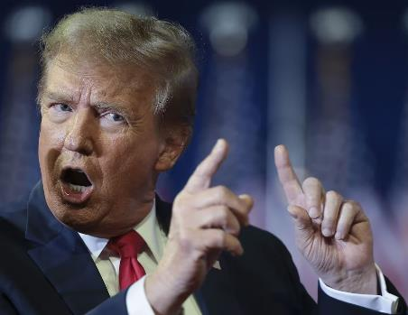
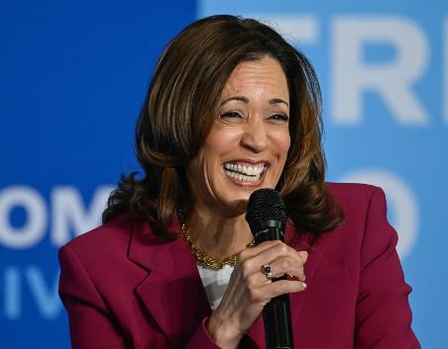

Most often seen example in your future work
Online profile collected for Marketing or Election
No Pet
White
Female
SUV
Garbage Truck
55-65
65+
No Pet
Upper Middle
Mixed
Male
Super Rich

Slide 9
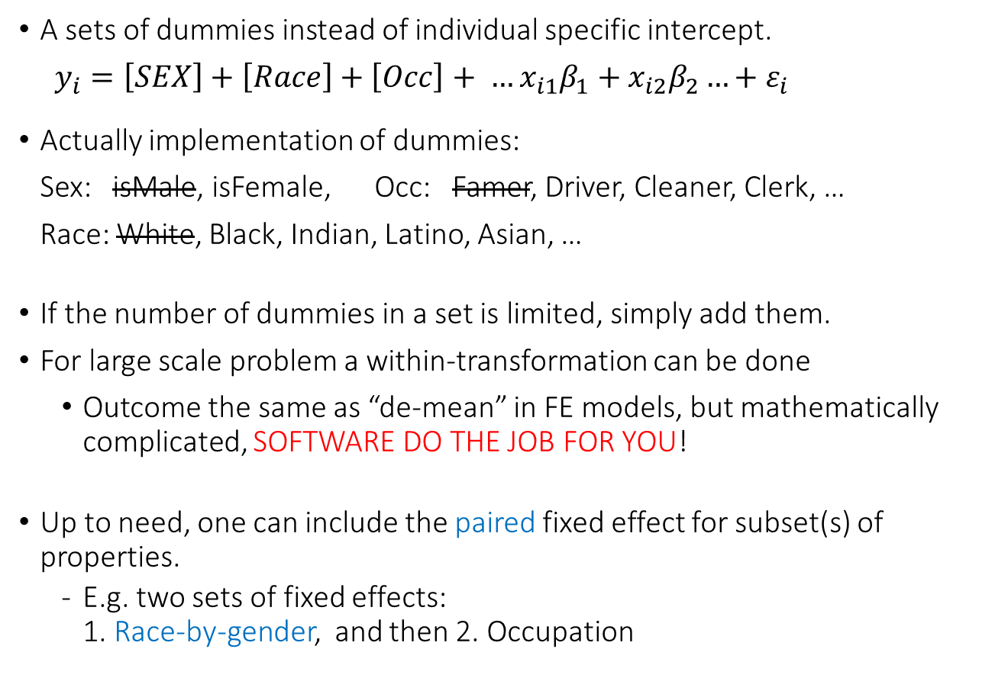
Estimating multi-dimensional fixed effect models
A sets of dummies instead of individual specific intercept.
$y_{i}=\left[SEX\right]+\left[Race\right]+\left[Occ\right]+ …x_{i1}β_{1}+x_{i2}β_{2}…+ε_{i}$
Actually implementation of dummies:
Sex: isMale, isFemale, Occ: Famer, Driver, Cleaner, Clerk, …
Race: White, Black, Indian, Latino, Asian, …
If the number of dummies in a set is limited, simply add them.
For large scale problem a within-transformation can be done
  Outcome the same as “de-mean” in FE models, but mathematically complicated, SOFTWARE DO THE JOB FOR YOU!
Up to need, one can include the paired fixed effect for subset(s) of properties.
  E.g. two sets of fixed effects:
  1. Race-by-gender, and then 2. Occupation

Slide 10
What you cannot do with multidimensional FEs?
Don’t overkill the entire population!
  Data: Country-industry level data for one year.
  YES: Country- and/or industry fixed effect.
  NO: Country-industry pair fixed effect.
Variables that are nested in, or doesn’t change alongside one fixed effect (or combination of several fixed effects).
  Adding a dummy for Low- and middle income, when controlled for income classes of L, LM, UM and H income fixed effect. (But you can derive it from weighted avg of relevant coefficients. )
  Language, initial year of GDP per capita, when already controlled for country fixed effect.
  World oil price, when already controlled for yearly FE.
  Initial productivity level, when controlled for country-industry FE.

Slide 11
What you can (and perhaps SHOULD) try
Interaction of a variable with FE, or with an invariant variable that was cancelled out by FE.
  A common misunderstanding that the above is impossible.
  This is also possible also for “typical” fixed effect models.
Assume you have a model with individual fixed effect.
  No sense to include gender or race.
  BUT it make sense to have:
  isFemale*t, isWhite*t, isAsian*t ...
  isFemale*Income, RaceDummies*Income
  E.g. isEnglishSpeaking doesn’t make sense with Country FE,
  but isEnglishSpeaking*ln(Trade/GDP) does.
  Dummies themselves don’t change over time, but interactions do.
  Captures the difference in time trend (or reaction to income) across groups. Sometimes these can actually be the core of a study.
Explore based on the detailed circumstances of a research…

Slide 12
Outline of Today
Multi-dimensional Fixed Effect & Examples
What is the Gravity model of trade & what do we use it for?
  PPML method in estimation
  Walkthrough of an empirical research that may give you some inspirations for master thesis.

Slide 13

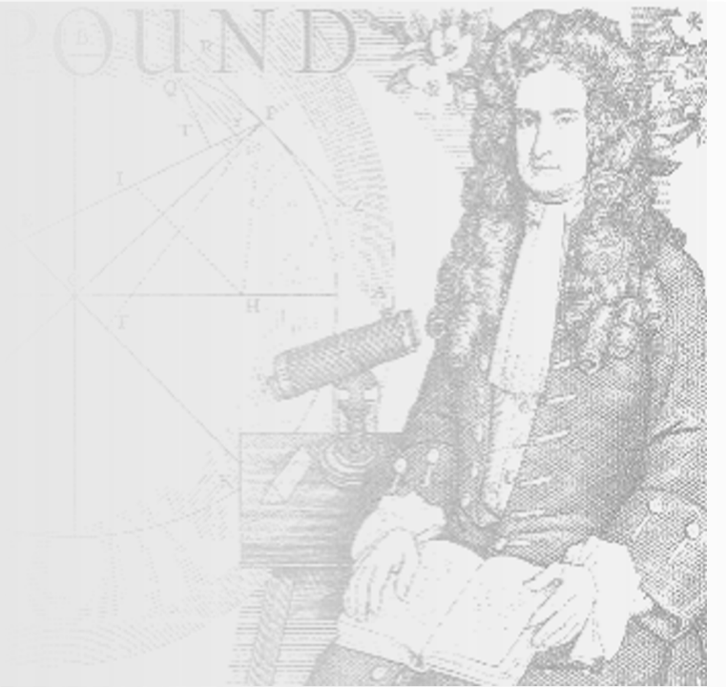
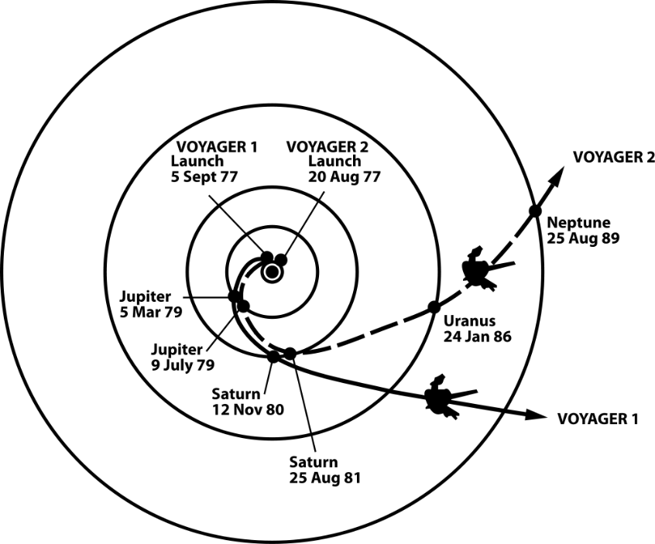

The Authentic Gravity Equation
“a particle attracts every other particle in the universe using a force that is directly proportional to the product of their masses and inversely proportional to the square of the distance between their centers.”
$$F=G\frac{M_{1}M_{2}}{r^{2}}$$

Slide 14



The gravity model in international trade
Tinbergen (1962)
“A country trade with every other country in the world to
an extent which is proportional to their economic mass,
and inversely (exponentially) proportional to the distance
between them.”
Be aware i and j stand for 2 countries, you may talk
about country fixed effects but it is not a “panel”.
Time dimension can be added, the unit identifier
is then the country pair of {i,j}
$$Export_{i→j}=G\frac{Y_{i}^{α}Y_{j}^{β}}{{Dist}_{ij}^{γ}}$$
??
…

Slide 15
The gravity model in international trade
Newton’s gravity is a physics law
  No president nor federal reserve chairman can stop it.
Gravity model in trade is no more than a empirical model.
  No consensus on an unambiguous theoretical foundation.
BUT:
  No proof, but well justified by different economic models, e.g.
  > Monopolistic competition that the variety of goods a country can offer
  is related with its economic size;
  > Recently very popular Eaton-Kortum model about Melitz type
  heterogeneous and random productivity of firms, etc
Practically popular; usually with sufficiently good explanatory power.
Very suitable for analyzing of trade barriers and facilitations.
User friendly & intuitive for research: plug & play like USB devices…

Slide 16


Intuition of distance
“Distance” determines the transportation cost of trade.
Longer distance -> higher trade cost -> lower trade
Other “influencers” of trade…
can be analysed in a similar manner…
$$Export_{i→j}=G\frac{Y_{i}^{α}Y_{j}^{β}}{{Dist}_{ij}^{γ}}$$

Slide 17
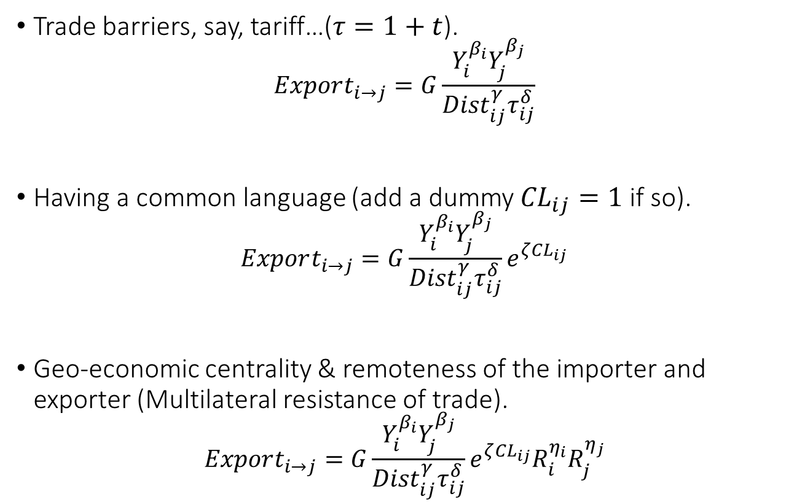
Adding elements to the gravity model
Trade barriers, say, tariff…($τ=1+t$).
$$Export_{i→j}=G\frac{Y_{i}^{β_{i}}Y_{j}^{β_{j}}}{{Dist}_{ij}^{γ}τ_{ij}^{δ}}$$
Having a common language (add a dummy ${CL}_{ij}=1$ if so).
$$Export_{i→j}=G\frac{Y_{i}^{β_{i}}Y_{j}^{β_{j}}}{{Dist}_{ij}^{γ}τ_{ij}^{δ}}e^{ζ{CL}_{ij}}$$
Geo-economic centrality & remoteness of the importer and exporter (Multilateral resistance of trade).
$$Export_{i→j}=G\frac{Y_{i}^{β_{i}}Y_{j}^{β_{j}}}{{Dist}_{ij}^{γ}τ_{ij}^{δ}}e^{ζ{CL}_{ij}}R_{i}^{η_{i}}R_{j}^{η_{j}}$$

Slide 18
Elements that you may think of
Properties of importing and exporting countries
  Economic sizes (GDP, consumptions),
  Infrastructures, trade protections, Environmental Standards,
  “Centrality & Remoteness”, and the so-called “Multilateral resistance”
Properties of the “pair” of countries
  (Physical) Distances measures (distance, border contingency, …)
  Socio-economic distances (similarity in language, culture, politics …)
  Bilateral and Regional Trade Agreements
  Tariff, Sanctions
Just “go ahead” and add to the regression as explanatory variable….
Some elements can be invariant, so watch out when fixed effect is used.

Slide 19
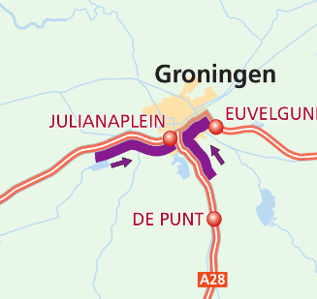
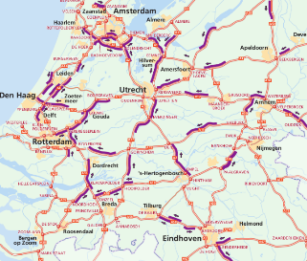
Other gravity-like research setup
Instead of bilateral trade flows, one may think of…
  FDI flows, foreign owned establishments,
  Airport passenger flows; immigration,
Subnational level (more complicated; not with our thesis):
  e.g. Living - working commuting traffic, in relation to:
  Traffic jams in certain places on high-ways;
  Trains of certain routes and time.
Leek
Haren
Roden
Drachten
Assen

Slide 20
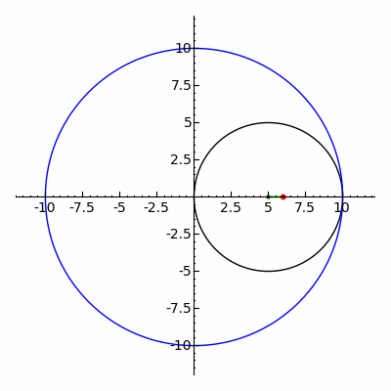
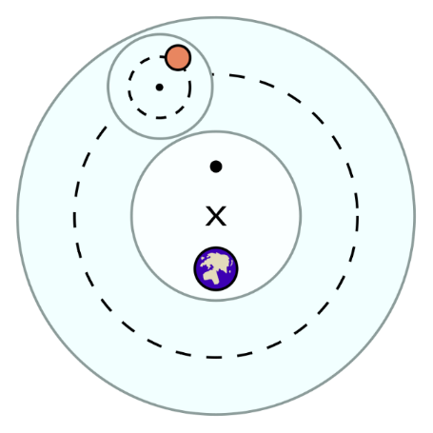
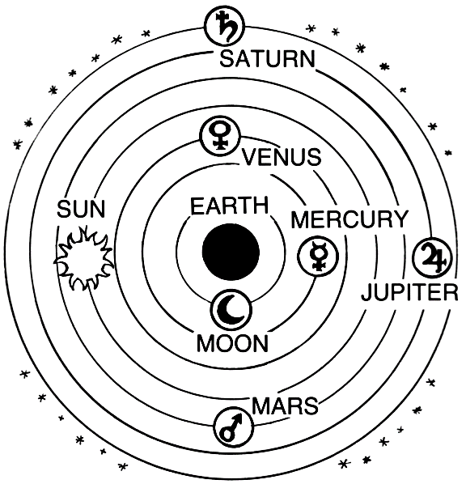
“Good enough for empirical use”
Adding items to the Gravity model

Slide 21
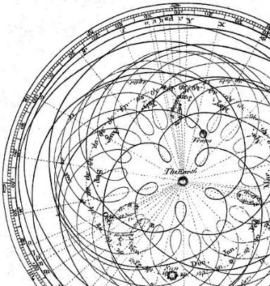
“Good enough for empirical use”
Adding items to the Gravity model
May not be “theoretically solid”
But empirically easy to analyse
Good enough explanatory
and prediction power
The world of social science
is not 100% precision anyway

Slide 22

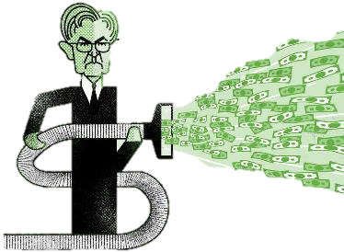


Slide 23

Estimating gravity model
Non-linear: a series of multiplications & divisions.
Frequently used trick: loglinearization transformation
  Basically: take log on both left & right side
  In gravity model: you get immediately a linear expression.
  Linearization by log (or other methods) often used in estimating (complicated) macro-econ models. Linear -> easier to estimate.
Need to test other stuff?
Just append in the list of independent variables.
$${EX}_{i→j}=G\frac{Y_{i}^{β_{i}}Y_{j}^{β_{j}}}{{Dist}_{ij}^{γ}τ_{ij}^{δ}}$$
  $$\ln{{EX}_{i→j}}=\ln{G}+β_{i}\ln{Y_{i}}+β_{j}\ln{Y}−γ\ln{{Dist}_{ij}}−δ\ln{τ_{ij}}+ε_{ij}$$

Slide 24
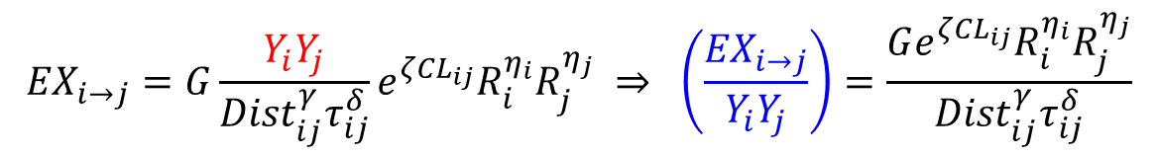
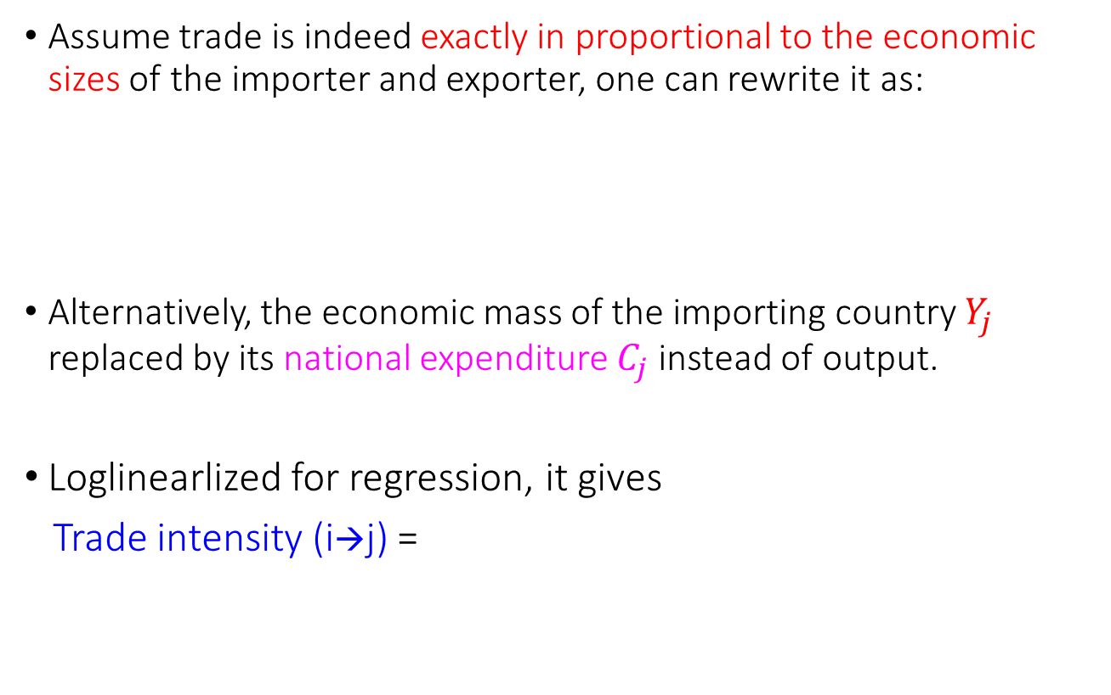
Alternative Specification
Assume trade is indeed exactly in proportional to the economic sizes of the importer and exporter, one can rewrite it as:
Alternatively, the economic mass of the importing country $Y_{j}$ replaced by its national expenditure $C_{j}$instead of output.
Loglinearlized for regression, it gives
Trade intensity (i→j) =
$${EX}_{i→j}=G\frac{Y_{i}Y_{j}}{{Dist}_{ij}^{γ}τ_{ij}^{δ}}e^{ζ{CL}_{ij}}R_{i}^{η_{i}}R_{j}^{η_{j}} ⇒ \left(\frac{{EX}_{i→j}}{Y_{i}Y_{j}}\right)=\frac{Ge^{ζ{CL}_{ij}}R_{i}^{η_{i}}R_{j}^{η_{j}}}{{Dist}_{ij}^{γ}τ_{ij}^{δ}}$$
$$\ln{G}+ζ{CL}_{ij}+η_{i}R_{i}+η_{j}R_{j}−γ\ln{{Dist}_{ij}}−δ\ln{τ_{ij}}+…+ε_{ij}$$

Slide 25
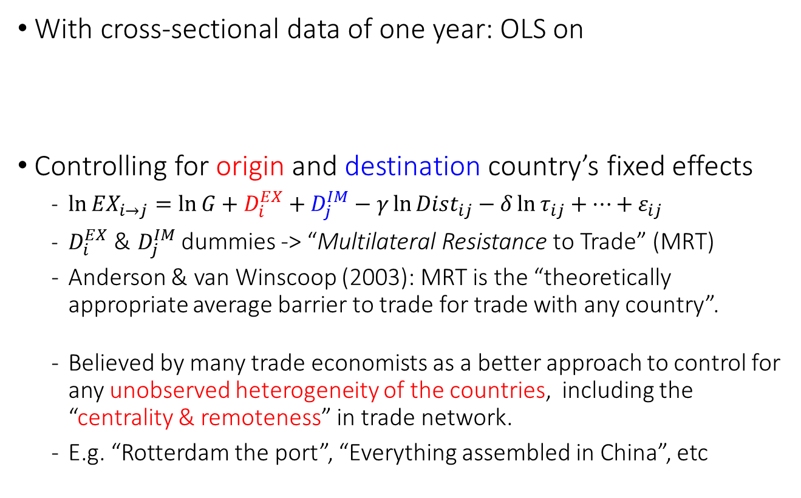

Recent approach in estimating the Gravity Model
With cross-sectional data of one year: OLS on
Controlling for origin and destination country’s fixed effects
  $\ln{{EX}_{i→j}}=\ln{G}+D_{i}^{EX}+D_{j}^{IM}−γ\ln{{Dist}_{ij}}−δ\ln{τ_{ij}}+…+ε_{ij}$
  $D_{i}^{EX}$ & $D_{j}^{IM}$dummies -> “Multilateral Resistance to Trade” (MRT)
  Anderson & van Winscoop (2003): MRT is the “theoretically appropriate average barrier to trade for trade with any country”.
  Believed by many trade economists as a better approach to control for any unobserved heterogeneity of the countries, including the “centrality & remoteness” in trade network.
  E.g. “Rotterdam the port”, “Everything assembled in China”, etc
  $$\ln{{EX}_{i→j}}=\ln{G}+β_{i}\ln{Y_{i}}+β_{j}\ln{Y_{j}}−γ\ln{{Dist}_{ij}}−δ\ln{τ_{ij}}+… +ε_{ij}$$
$$β_{0}$$

Slide 26
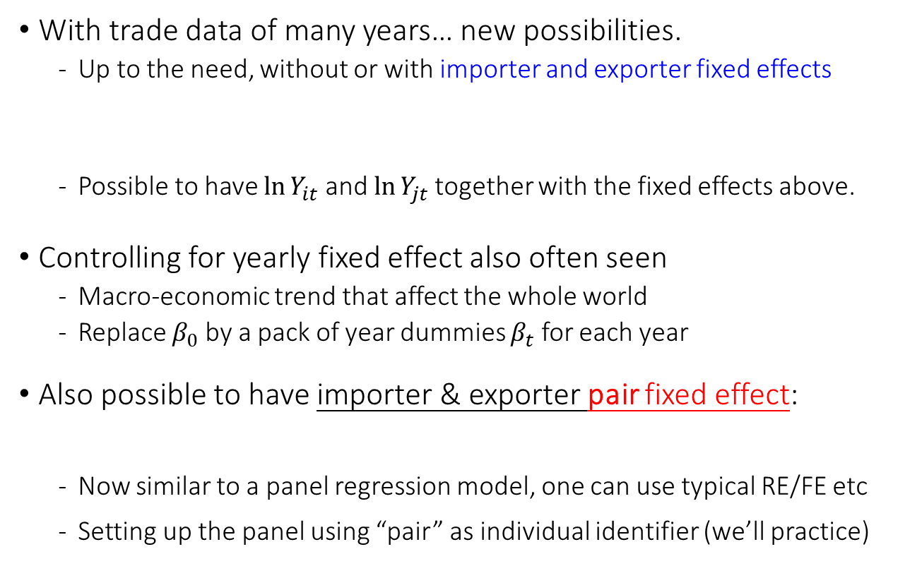
Estimating the Gravity Model
With trade data of many years… new possibilities.
  Up to the need, without or with importer and exporter fixed effects
  Possible to have $\ln{Y_{it}}$ and $\ln{Y_{jt}}$ together with the fixed effects above.
Controlling for yearly fixed effect also often seen
  Macro-economic trend that affect the whole world
  Replace $β_{0}$ by a pack of year dummies $β_{t}$ for each year
Also possible to have importer & exporter pair fixed effect:
  Now similar to a panel regression model, one can use typical RE/FE etc
  Setting up the panel using “pair” as individual identifier (we’ll practice)
$\ln{{EX}_{i→j,t}}$ $=β_{0}+β_{i}\ln{Y_{it}}+β_{j}\ln{Y_{jt}}−γ\ln{{Dist}_{ij}}−δ\ln{τ_{ijt}}+…+ε_{ijt}$
$\ln{{EX}_{i→j,t}}$ $=β_{0}+D_{i}^{EX}+D_{j}^{IM}+β_{i}\ln{Y_{it}}+β_{j}\ln{Y_{jt}}−γ\ln{{Dist}_{ij}}−δ\ln{τ_{ijt}}+…+ε_{ijt}$
$\ln{{EX}_{i→j,t}}$ $=β_{0}+D_{ij}+β_{i}\ln{Y_{it}}+β_{j}\ln{Y_{jt}}−γ\ln{{Dist}_{ij}}−δ\ln{τ_{ijt}}+…+ε_{ijt}$
+

Slide 27
Estimating the Gravity Model
“Advantage” in using pair fixed effect:
Endogeneity in signing a Free Trade Agreement
Basic estimation: add a dummy FTA_{ijt}, indicating whether two countries i and j has an agreement at time t.
  Very instable outcomes in literature about its effect.
Bergstrand and Baier (2007): FTA is not random, but a choice.
  Possibility of reverse causality in having FTA.
  “Evidence for Friendship”; even before FTA is signed, two countries already trade a lot. FTA’s role over-estimated.
  As a tool for harmonizing regulations.
  FTA’s role is under-estimated.
The “relation” between two countries is captured by the pair-fixed effect (“long-term friends” or with major differences).

Slide 28

Problems with log transformation
Minor problem: Jensen’s inequality
  Estimates are made on the basis of the log of trade flows.
  Good for predicting “growth rate”. But:
  Sometimes we are interested in the level of trade.
  Unbiased in logarithm =/= Unbiased in the levels
  Jensen’s inequality:$E\left(f\left(x\right)\right)>f(E(x))$ if f(.) is convex, so $E{(e}^{x})>e^{Ex}$.
Y = Trade
E(Y)
exp(E(X))
Transformed
X=ln(Trade)
E(X)

Slide 29
Problems with log transformation
A More Serious Problem in taking logarithm:
  When data of all countries of the world are used, many country pairs do not trade with each other.
  Log of zero is undefined: it will appear as missing data.
  “No trade” = Zero trade. Log of zero = Missing…
  BUT: Zero is a valid observation, not “missing data”.
  And this pattern of “missing data” is not random.
  Real world data: many small country pairs do not (directly) trade with each other. You miss a substantial share of pairs.
  Sampling bias: the estimates tend to over-represent the pattern between larger countries (pairs).

Slide 30

The way out:
A “sloppy” way many people were using in the old days:
  ln(0) won’t work, so let me do the this transformation:
  Use ln(Export + 1) as the dependent variable! :-)
Don’t do that (in the 21st century)…
  Results change up to the scaling in the measure of export;
  The “1” will have different impacts, if export is denoted in dollar, thousand, million, or billion.
  So, don’t do that with trade data!
…

Slide 31
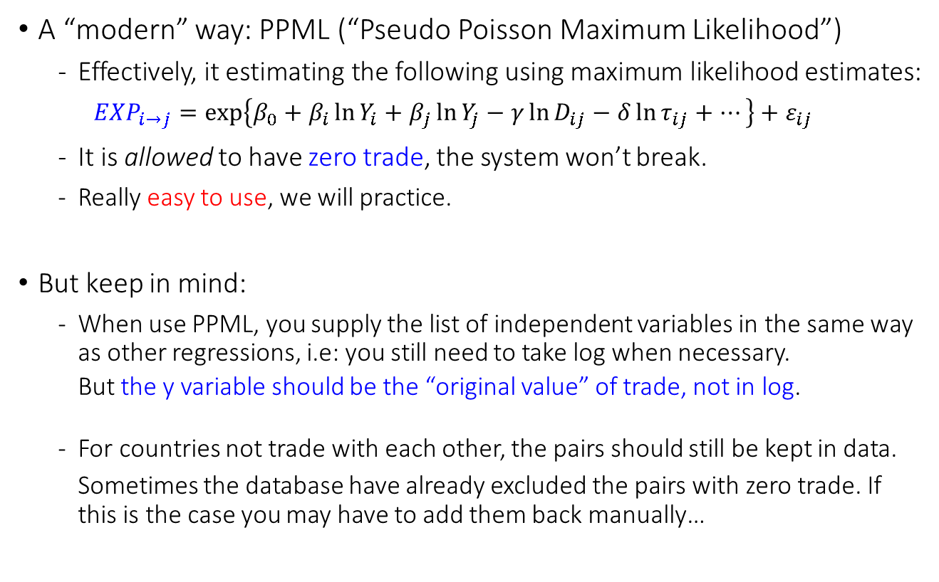
The way out
A “modern” way: PPML (“Pseudo Poisson Maximum Likelihood”)
  Effectively, it estimating the following using maximum likelihood estimates:
  $${EXP}_{i→j}=\exp\left\{β_{0}+β_{i}\ln{Y_{i}}+β_{j}\ln{Y_{j}}−γ\ln{D_{ij}}−δ\ln{τ_{ij}}+…\right\}+ε_{ij}$$
  It is allowed to have zero trade, the system won’t break.
  Really easy to use, we will practice.
But keep in mind:
  When use PPML, you supply the list of independent variables in the same way as other regressions, i.e: you still need to take log when necessary.
  But the y variable should be the “original value” of trade, not in log.
  For countries not trade with each other, the pairs should still be kept in data.
  Sometimes the database have already excluded the pairs with zero trade. If this is the case you may have to add them back manually…

Slide 32

Outline of Today
Multi-dimensional Fixed Effect & Examples
What is the Gravity model of trade & what do we use it for?
  PPML method in estimation
  Walkthrough of an empirical research that may give you some inspirations for master thesis.
  Steven Brakman, Harry Garretsen and Tristan Kohl (2018)
  Simulating alternative scenarios of Brexit

Slide 33
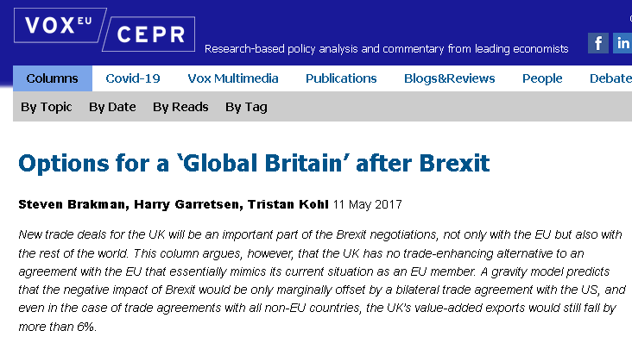
Brexit and its impact on value-added trade
Brakman, Garretsen, Kohl (2018)
“Consequences of Brexit and options for a Global Britain”.
A Non-tech summary
  https://voxeu.org/article/options-global-britain-after-brexit
  There are many up-to-date research presented in voxeu.org, might be a good place to explore for a research topic.

Slide 34
“Value-added Export” (VAE)
What is, value, added, trade??!
  => “Trade, Environment and Growth”…
  The values created by a country but absorbed in final use by another.
  More closely related to the actual locations and activities in creating the values of trade goods.
Gross Export of iPhone from CN to NL consists of
  VA by Chinese assembly workers (VAE from CN to NL)
  But also the chips which was made in the US; VAE from US to NL.
Gravity in VAE can be also estimated like (regular) export flows in a gravity model.

Slide 35
Brexit and its impact on value-added trade
Strategy in a quick glance:
  Collect information about FTA in the world (WTO website).
  Calculate the “value-added trade flows” between countries in 2014. (Similar to Matlab assignment of your course).
  Bring them together….
  Use value-added trade flows to estimate a gravity equation,
  with the key independent variable the FTA dummy.
After estimation:
  “Switch off” FTA dummy from 1 to 0 between UK & EU countries.
  Predict the changes in trade before & after…
$$\ln\left({VAE}_{i→j}\right)=β_{0}+β_{1}\ln{GDP_{i}}+β_{2}\ln{GDP_{j}}+β_{3}FTA_{ij}+ …$$
$${VAE}_{UK→NL}{=\exp\left\{\hat{β_{0}}+\hat{β_{1}}\ln{GDP_{UK}}+\hat{β_{2}}\ln{GDP_{NL}}+\hat{β_{3}}\left[1→0\right]+…\right\}}$$

Slide 36
Brexit and its impact on value-added trade
Beyond a standard gravity model
  Using a “full endowment general equilibrium” approach, estimate the changes in “remoteness” & “centrality” of each country.
  i.e. “Multilateral resistance to trade”; Isolated countries rely more on domestic trade, and less international trade.
  UK disconnected from EU -> UK itself will be more “remote”.
  EU also disconnected from UK.
  Some others (US, China, etc) might becomes more central in the world trade. Possible to be the winners…
  (but not finding much indirect effect)

Slide 37
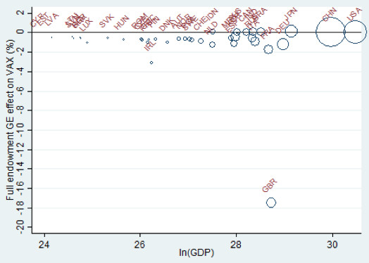



Brexit and its impact on value-added trade
% Chg in Value-added Export

Slide 38
Simulation of other scenarios possible
Hard v.s. even harder Brexit:
  UK may also lose trade deals with third-party countries which were signed after it joined EU -- i.e. legally EU and not individual country is the signing party and it is up to the third-party country to decide whether the agreement will be extended to UK after its exit.
“Global Britain”
  UK will success in new deals with other important trade partners (US, CN, etc) on its own, which don’t yet have FTAs with EU.
How to simulate? “Switch something on and something off…”
$${VAE}_{UK→CN}{=\exp\left\{\hat{β_{0}}+\hat{β_{1}}\ln{GDP_{UK}}+\hat{β_{2}}\ln{GDP_{CN}}+\hat{β_{3}}\left[0→1\right]+…\right\}}$$

