Slide 1
Empirical Research Projects (for Intl. Business)
Tutorial Week 1

Slide 2
About me
Xianjia Ye
  Assistant Professor in Groningen Growth and Development Center
  From China, did PhD in the Netherlands.
  Worked before in Utrecht University (and still lives there)
My E-mail: x.ye@rug.nl
For administrative matters:
  Secretary: gem.feb@rug.nl
  Lecturer & Coordinator (Prof. Eda Aral-Kilic): e.aral.kilic@rug.nl
Do’s and Don’ts
  Make sure to mention the name of this course, and your personal information (name, student number, tutorial group number).
  Do NOT send emails to multiple people!

Slide 3
What do we expect from you in the tutorials?
Be prepared
  Study the questions before the class
  At least get familiar with the questions…
Be here
  Listen to the answers but also ask questions
  Answer questions actively.
  Join the discussion, support learning of each other

Slide 4
About the assignments
We are finalizing the details and enrolment will open soon.
Two assignments. The same team (4 students) for both.
Get together and have a talk: you will together work on the two assignments, every teammate should contribute.
When assignment is posted: Read firstly carefully the guidelines…
Repeaters who want to re-use grade from the past:
  NOT possible any more…

Slide 5

Question 1
A student plans to research the relationship between companies’ CSR activities and their reputation for her/his bachelor’s thesis.
For this, s/he considers two options
  Surveying people to collect data about companies’ reputations.
  Use datasets online where similar information is shared.
Evaluate the student’s choices by considering the differences between primary and secondary data.

Slide 6
Question 1
What are they?
  Primary: “first hand”, collected by researchers themselves.
  Survey, observations, experiments, questionnaire, personal interview etc.
  Secondary: collected by others, usually ready-to-use.
  Publication from official sources and other data agencies, websites, books, journals, other records.

Slide 7
Features of Primary & Secondary data
Primary data
Collected by the researcher.
First hand, always original
Guaranteed consistence
(by yourself)
Can be customized on the exact research question.
Costs of collection
Efforts in processing
Personal prejudice
Secondary data
(relatively) Cheap
Quick; Ready-to-use
Objective
Collected by other agent(s). May not be systemically collected.
May not fit well with the research question.

Slide 8
Question 2
In an IB research project on performance, how to determine which type(s) of performance measures to include?
What are the types of performance measures for firms?
  Financial; Operational; Overall. (Hult et al.)
  Financial; Operational; Organizational effectiveness (Richter et al)
Make a choice? It depends on your research question.
  Find the best match(es), But in most cases: no need for all.
  Think for data source (primary/secondary), check availability & quality.
  External validity (whether the results can be generalized).
  Also depends on the level of analysis (next question).

Slide 9
Question 3
Do we need to measure performance at all levels of analysis?
What are the levels of analysis?
  Firm, Strategic Business Unit (SBU); Interorganizational Unit (country, region).
  Again, no need for all. Find the best match(es).
Analyzing @ different levels may yield different outcomes.
  E.g. iOS itself, v.s. the whole business unit of iPhone.
  May also happen with different data type(s) & source(s).
  Sometimes good as a check, not (always) necessary.
  Be clear and careful in interpretation and conclusion.
Make sure what you do and you use matches your research question!

Slide 10
Discussion 4: Critically Evaluate the RQs briefly
a. How do MNCs’ subsidiary staffing strategies affect their foreign subsidiary performance?
b. To what extent does host-country experience interact with subsidiary staffing strategies in determining MNCs’ subsidiary performance?
Are they relevant for IB?
Are they clear enough? Are they too broad or too specific?
Are they suitable for empirical research, meaning that the related variables are measurable / observable?
Are they feasible for a bachelor’s thesis?

Slide 11
Question 5 – Selection Bias
According to the paper by Hult et al. (2008):
  “it is important to note while restricting the sample to firms adopting
  harmonized standards may introduce selection bias issues: for example,
  if the population of firms that adopt harmonized standards is fundamentally different from those who do not, researchers must interpret the implications
  of their findings conservatively”.
5.1 What is a selection bias?
  The probability a data point is included in the research is not random.
  Ends up in a “non-representative” group of the population.
Various causes
  Natural reasons (e.g. survival bias),
  Flawed research design; or on purpose.
  (Also many others…)

Slide 12

Survival bias
“University Education is useless!”

Slide 13
Flawed research design
Randomize is important. If not properly randomize, samples may be representative in some sense but may not be representative along some other specific dimensions.
How many vegetables do people eat every week?
  You design a questionnaire and you go to a local farmers’ market on Saturday to ask people there.
Local farmers’ market is mostly for selling fresh vegetables and fruits from local.
Customers who visit the farmers market are very likely to eat more vegetable than average population.

Slide 14
Selection Bias
Randomization is usually the key to guarantee representativeness.
  But also watch out!
Select random firms who have reported a profit last year.
  Perhaps the sample is representative in firm’s size.
  But the subset of loss-making firms is systemically excluded.
  Lack of representativeness affects results and conclusions
Generating a bias on purpose?
“Purposeful” selection bias that you may want to watch out:
  “Research shows that more than 95% of our employees are happy!”
  Watch out for claims like this when you look for jobs!

Slide 15
Question 5.2
How to check statistically the representativity of your sample?
Whether selected sample differs fundamentally from the others.
  Before moving to statistics, first use some common sense.
  And then think in IB and/or Economic logic about the sampling strategy.
Select a few key indicators for the comparison, what you may do
  For continuous variables:
  Check the difference in the means of sample/population.
  To make statistical inference: t-test, (paired test v.s. testing two independent groups, equal or different variance, etc etc)
  Compare the distributions for categorical variables:
  e.g. Employment = { 'Public Sector', 'Private Firms',
  'Self-employed', 'Unemployed‘ }
  Chi-2 test

Slide 16
Question 5.2 – Methods for doing such t-test
Du, Deloof and Jorissen (2015: 174):
“We design the questionnaire [...] In the initial questionnaire survey (conducted December 2008) and three follow-ups, 87 (21%) questionnaires are returned [...] We check the nonresponse bias by comparing the size, industry, and headquarters country of our respondent subsidiaries with the research population. Results from a t-test show that, on average, the size of our respondent subsidiaries is not significantly different from that of the research population (t = .73, p= .46).”
Hult et al.:firms that adopt harmonized standards is fundamentally
different from those who do not
What is the difference with the Hult et al. (2008) approach?
Evaluate the difference.
  Hult et al. “compare with the subgroup that is not in the research.”
The method from Hult et al more favourable.
  Adding the Rich into the Poor makes the average closer to the Rich…

Slide 17
Question 5.2 – Methods for doing such t-test
Du, et al (2015): comparing a sub-sample to the whole research population (e.g. comparing group A to A+B).
Hult et al. (2008): comparing the two sub-samples, not with population (e.g. comparing group A and B)
Comparing the two samples is preferred.
  The characteristics of A influences the characteristics of A+B, so
  A is clearly closer with A+B, than with B…
  It is therefore easier to conclude that sample A is representative by comparing to A+B, but this can be an illusion.
Comparing to the entire population including your sample is OK, when the sample is small compared to the population. If so, its influence on the population characteristics is negligible

Slide 18

5.3 making wrong comparisons…
a. “More people were killed by airplanes last year than in 1910.”
  There is simply much more air traffic.
b. “The death rate in the Navy during the Spanish-American war was nine per thousand. For civilians in New York City during the same period it was sixteen per thousand.”
  The military is made up mainly of young men
  and they are among the best in health in the
  whole population.
  A civilian population includes infants, the old,
  and the ill, all of whom have a higher death
  rate wherever they are.
  These figures do not at all prove that being
  in the navy will make you live longer

Slide 19
6. Types of variables
Have a look at pages 1325-26 where the variables introduced in the model are described. With the information provided on pages 1325-26, answer the following questions:
Which variables in the analysis are dichotomous or dummy variables? Define the category that takes a value equal to 1.
Which variables are continuous variables?

Slide 20


Types of Variables
Ratio variables are obvious.
  Continuous variable (integers or with decimal), and have “true zero"
Nominal/Categorical variables :
A variable that can takes two or more categories,
but there is no intrinsic ordering to the categories.
Example
AnimalType = {'Cat', 'Dog', 'Fish'}

Slide 21
Types of Variables
Dichotomy or Dummy variable:
Can only take 2 values, 0 or 1.
IsCat
1
0
0
0
A variable with only 2 possible values may not be a dummy variable, e.g.
IsEnrolled = {0, 1} <- A dummy Variable
EnrolmentStatus = {'Enrolled', 'Not Enrolled'} <- Nominal Variable

Slide 22
Types of Variables
Ordinal Variables:
Similar as categorical, but with a clear ordering of the categories.
Example: Access permission control to certain documents
Access = {'No Access', 'Read Only', 'Read and Modify'}
Scale/Interval:
Ordered, but now the difference between the two categories are numerically meaningful.
Example:
Temperature in Celsius and Fahrenheit.
MonthlyWageRange = {'minimum wage to 3000',
'3000 to 4000', '4000 to 5000',
'5000 to 6000', 'Above 6000',}

Slide 23
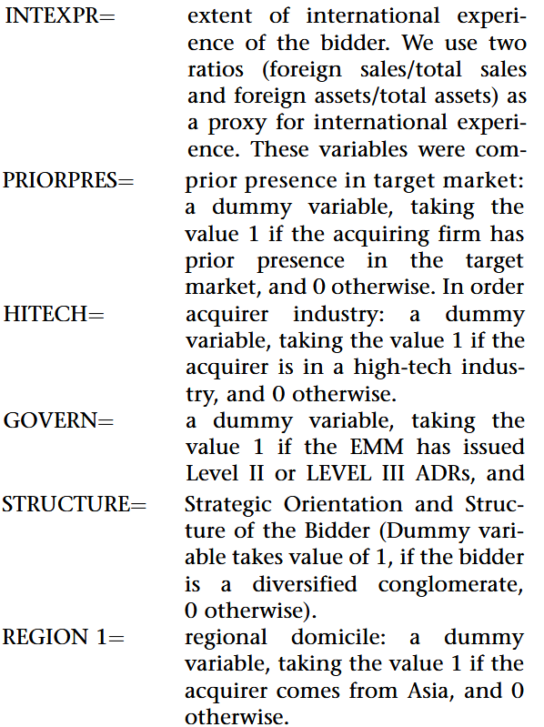
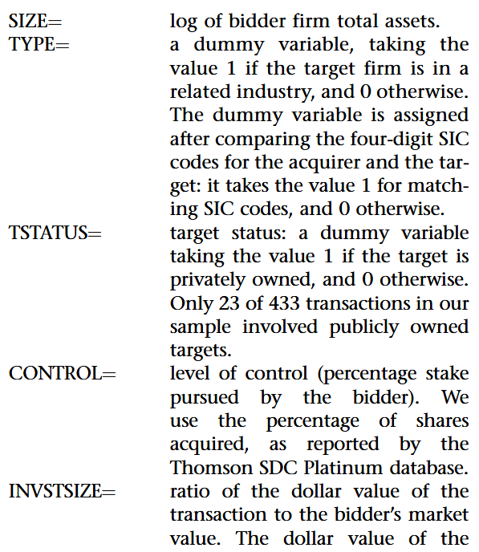
6a Which variables are dichotomous or dummy variables?
Define the category that takes a value equal to 1.
6b. Which are continuous variables?

Slide 24
Active Participation Quiz
Quiz 1
For a research about wage differences across industries,
How would you measure wage? Whose wage information should be collected?
Answer in groups of 2-3 students.
Do it on paper.
Firstly: Write your names & Student numbers

Slide 25
Quiz 2
A team of researchers examines the implications of CEO foreignness for a firm’s corporate social performance (CSP), and how firm’s profitability is associated with this relationship. (details will be displayed in the next slide)
Describe the data types of the variables used in the hypotheses. Explain your answer by discussing the characteristics of the respective data types.

Slide 26
Quiz 2
Firm profitability information is computed using data form firm financial tables as the return on assets (ROA), corresponding to earnings before interest and taxes, divided by total assets.
CSP (Social Pillar Score) is obtained from a data source, where firms’ environmental, social and governance actions are scored. Researchers use “Social Pillar Score”, which measures a firm’s capacity to generate trust and loyalty with its workforce, customers, and society, through its use of good management practices. Each firm is rated by an integer from 1 to 5, higher scores correspond to better CSP.

